Slide 1

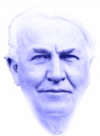

“To invent, you need a good imagination
and a pile of junk”
- Thomas Edison
Notes:
Good evening everyone. We are Team Gambit’s Six. I’m Josh Keck and these are my partners Michael Dannals, Jodie Vance, Mengying Cao, David Fisher, and Amanda Sellers. A long time ago there lived a young boy. There wasn't anything spectacular about this young boy, not on the outside. He was cute and friendly and his parents thought he was very special, but most people who passed by him on the street wouldn't notice how extraordinary this little boy was. What made him so special was beyond what people could see. What made him special was deep within his mind, it was his imagination. (((Click)))). I could be talking about any little boy, but our little boy was Thomas Alva Edison. He would go on to change the world and be the greatest inventor of his time because he never stopped using his imagination.

Slide 2




GE ranked
#3
“In 2012, we made strategic decisions in key areas that will drive growth in the company and create better outcomes for our customers and the world.”
Forbes Global 2000
Notes:
In 1890, Thomas Edison established the Edison General Electric Company, which would later become just General Electric. (((Click)))). Today GE is the third largest company in the world. It has operated in as many industries and markets as Edison had ideas. (((Click)))). Right now if you look on GE’s website, you’ll find this quote: “In 2012, we made strategic decisions in key areas that will drive growth in the company and create better outcomes for our customers and the world.” GE is changing the world today just as Thomas Edison did a hundred years ago. And its doing it (((Click)))). with imagination. Before we get into the case, let me go over a brief history of the last decade.

Slide 3

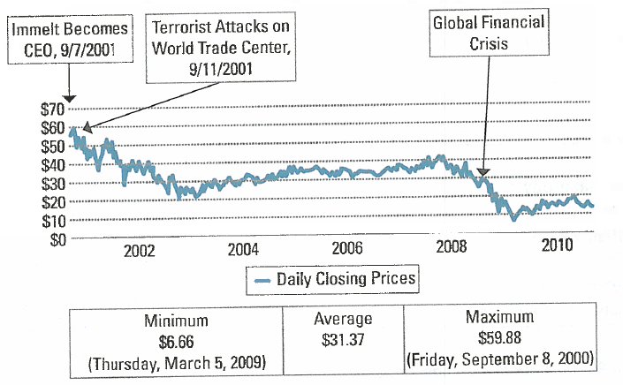
Notes:
TIME Magazine called the first decade of the new millennium The Decade From Hell. This is especially true for Jeff Immelt. (((Click))). Jeff Immelt assumed his role as CEO of GE on September 7, 2001, just four days before the 9/11 terrorist attacks. (((Click))). Since that tragedy, Immelt has spent his time putting out fire after fire. The U.S. Economy was pushed into a recession and a global economic slowdown began. GE’s stock price fell, the company was forced to drop 10% of its workforce, their credit rating was downgraded, and their market capitalization had been cut in half. As the financial crisis persisted, it became clear to both Immelt and GE’s investors that GE needed to rethink its corporate strategy. Immelt believed the key to future success (((Click))) was in positioning GE away from declining businesses and toward the rapidly growing industries of the future. Immelt needed Imagination not AT work, but TO work.

Slide 4
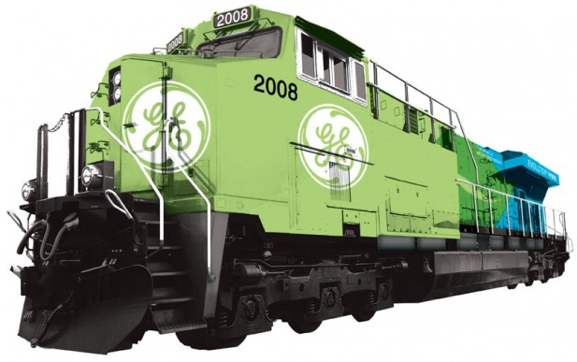






2005 GOALS Double R&D to $1.5B on “green products” Work with customers to increase revenues from $5B in 2005 to $20B by 2010 Reduce GE carbon footprint by 1% Be transparent and involved | 2009 STATUS $1.5B on R&D for 75 “eco products $18B of revenue in 2009; 17% growth rate Global engagement Reduction of 8%; save $100 MM/year Founding member of USCAP.
Notes:
And he started with Ecomagination, which began in 2005. (((Click))). Ecomagination was intended to develop “tomorrow’s solutions” such as solar energy, hybrid locomotives, and efficient lighting. Ecomagination proved to be a success. Within 4 years GE had met many of its goals. Revenue had grown 17% annually and GE’s carbon footprint had been reduced by not 1%, but 8%. Immelt learned through the ecomagination experience that with innovation, all stakeholders can win. (((Click))). Now, even though ecomagination was a success, it wasn’t enough to return GE back to its former glory pre-9/11. It would take more than this - GE would need a repeat performance.

Slide 5
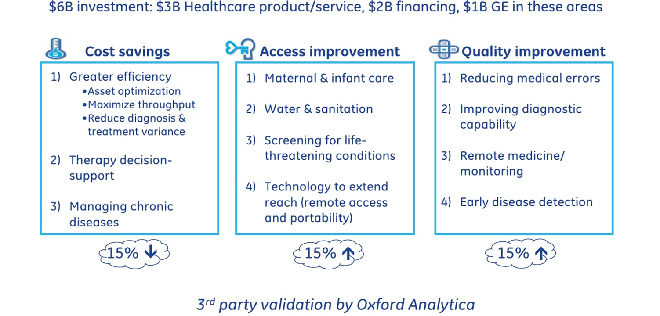


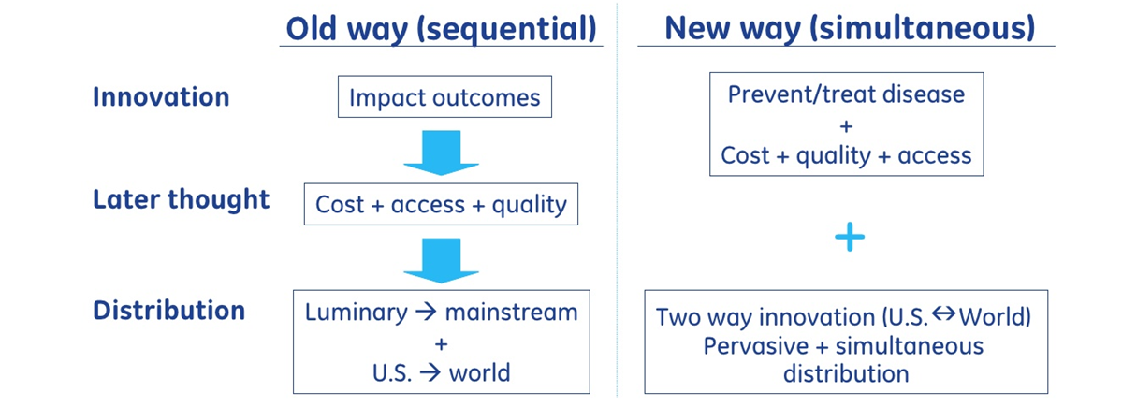
Notes:
And so was born “Healthymagination.” The focus of our presentation today is to report our analysis of the case “Healthymagination at GE.” (((Click.))) Healthymagination is a new initiative charged with creating lower costs, greater access, and higher quality around the world to much needed healthcare technologies. Ultimately Immelt saw lack of access to adequate healthcare as not just an American problem, but a global ill. He believed that GE, with its international reach and influence, was in a unique position to create global cooperation and health-related innovation. (((Click))). To make that happen, he developed a new model of simultaneous innovation. Before, innovations were pushed from developed countries into developing countries and cost, access and quality were the last thing to be addressed. This new model promotes simultaneous innovation in both developed and developing countries with the cost, quality, and access as the main concern. (((Click))). While ecomagination grew naturally from GE’s strengths in industrial engineering, healthymagination would be present new challenges.

Slide 6
“Simultaneous Innovation” simultaneously sway investors and managers?
Are we there yet??
Sustainable Competitive Advantages??
Notes:
Will healthymagination create sustainable competitive advantages amidst a capricious healthcare environment? GE is a problem-solving company, (((Click))) but will its new model of “simultaneous innovation” be enough to create viable products while simultaneously swaying investors and managers? (((Click))). Moreover, how much longer will Immelt’s supporters wait to reap the full benefits of his far-reaching strategic endeavor? The following report will address these problems and more. And now I’ll hand the discussion over to Michael to discuss the Corporate Level Strategies

Slide 7
Corporate Level Strategy
What is GE?
Conglomerate
Unrelated Diversification
Powerhouse

Slide 8
Operations
Zhuhai
Industrial Manufacturing
Energy
GE Capital
Healthcare
Singapore
Notes:
Here you see GE’s four main areas of operations within its corporate structure. (((Click))) Before the 2008 financial crisis, GE Capital represented 50% of the firm’s profits. GE was able to use that money to fund other projects in industrial manufacturing, energy projects such as the Ecomagination initiative, and healthcare projects such as Healthymagination starting in 2009. But during the financial crisis, GE was hit especially hard because of its reliance on GE capital. Once a key resource utilized to finance acquisitions and smooth quarterly earnings for other division’s, GE Capital’s losses were now a drain on the overall health of the firm, acting as a vacuum on the share price. (((Click))) Immelt saw the financial crisis as an opportunity to move the company away from its dependence on GE Capital and toward a new identity for the 21st century. He believes slimming down GE’s reliance on this division will help the company over the long-haul to deal with a volatile economic environment.

Slide 9
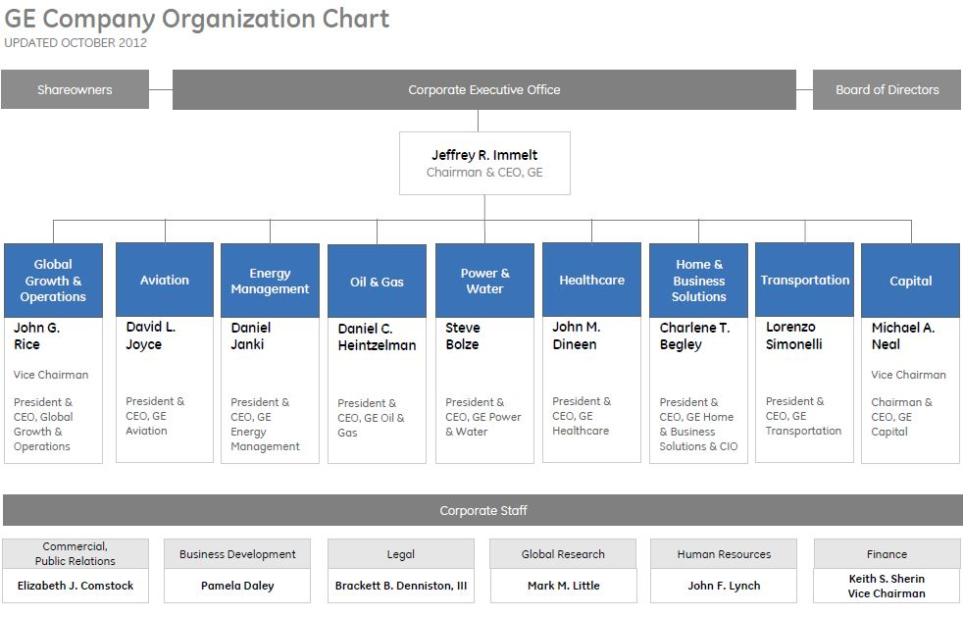
Notes:
This is GE’s organizational chart. As you can see, it is a multidivisional organizational chart typical of diversified organizations. This chart is constantly changing and evolving as GE gets in and out of businesses over time. The four main areas of operations I just described are spread out into these 9 divisions. Energy is composed of Energy Management, Oil & Gas, and Power & Water. Healthcare is simply the healthcare division. Industrial Manufacturing consists of Aviation, Transportation, and Home and Business Solutions. Global Growth and Operations are coordinated across all the other divisions of the firm, particularly with the Healthcare division under the new method of simultaneous innovation outlined in the Healthymagination project.

Slide 10
Acquisitions
Joint Venture
Most subsidiaries and businesses.
Acquired a series of healthcare businesses in order to play “catch up” in the healthcare industry.
Most notable – GE and Comcast for NBC Universal (2009).
GE and Synthesis Energy Systems, Inc. for Small Scale Power Generation Solution (2013) **(Joint Market)**
Notes:
GE utilizes both Acquisitions and Joint Ventures when getting into new industries and markets. It would be impossible to list all of the acquisitions GE has made given the room on this board, but know that they acquired a large series of businesses in order to play “catch up” in the healthcare industry. Notable Joint Ventures have included cooperation with Comcast over NBC Universal in 2009, and a joint venture with Synthesis Energy Systems just this week. When operating internationally, it often chooses to share the risks through joint ventures. Its also important to note that GE has seen organic growth in many of its businesses, namely in industrial manufacturing. Now that I’ve told you about the corporate level strategies, Jodie will discuss GE’s business level strategies.

Slide 11
Business Level Strategies
Product Differentiation
Product Features
Product Complexity
Timing of Introduction
Location
Product Customization
Reputation
Cost Leadership
Vertical Integration
Learning Curve
Scale Economies
Scope Economies
Process Innovation
Notes:
GE manages each of its businesses as if they were independent entities, but a common theme among them is the use of a product differentiation strategy that focuses on product features, product complexity, timing of product introduction, and location. GE also uses product customization and reputation to help link the firm to the customers. (((Click))) Several of GE’s businesses possess cost leadership advantages as well, mainly through vertical integration, learning curve economies, scale economies, scope economies, and process innovation. (((Click)))
The dynamic duo of these generic strategies make it so that GE does not need to position itself relative to competitors, but rather competitors are forced to position themselves to GE. GE positions itself as a leader throughout many different industries because of their focus on innovation and imagination; therefore competitors are often forced to take a cost leadership approach.

Slide 12
Functional Strategies
Focus on improving production goals through Six Sigma and Total Quality Management Systems
Emphasis on accountability
Blue Ocean Strategy – GE makes the competition irrelevant
Notes:
Functional strategies support GE’s role as a multi-industry leader. GE focuses on its core competencies and is continually trying to improve production goals in mature industries by using Six Sigma and Total Quality Management systems. Moreover they look at accountably as one of the best ways to establish better internal functionality and product quality.
Firms typically fall under either one of two strategies, red ocean or blue ocean. Red ocean occurs when sharks compete without mercy for the action, or to say, firms attack each other for a share of a fixed market. Blue ocean strategy is where you have the water to yourself. GE pursues a Blue Ocean strategy because its goal is not to eliminate the competition, but rather to make the competition irrelevant to GE’s goals by decreasing segments of the markets to competitors or increasing the size of the market as a whole.

Slide 13
Healthymagination
Combination of a cost leadership strategy and product differentiation strategy
15% lower costs,
15% greater access
15% higher quality
Notes:
It would be impossible to discuss the business strategies of each of GE’s businesses, but for the purpose of our case, we decided that the Healthymagination project was the business strategy we needed to focus on. Healthymagination doesn’t use a cost leadership or product differentiation strategy – but rather it uses a combination of both of these as it seeks to tackle the global healthcare industry. GE has been highly active in Healthcare since the 1980s, but before its emphasis was on highly complex machines that were extremely expensive and specialized.
But now, Healthymagination’s focus is on creating healthcare technologies with at least 15% lower costs, 15% greater access, and 15% higher quality. The lower costs make it a cost leader, the greater access allows products to be matched to specific local needs, and the higher quality increases the perceived value of their products compared to competitor’s. Speaking of competitors, I’m now going to hand the discussion over to Mengying to discuss GE’s external environment.

Slide 14
General environment
Technological change:
GE is a leader in technological change
2004: Spent $700 million on clean technology
2005: Launched Ecomagination
Cultural trends: The difference between Chinese and American cultures.
Notes:
Good evening everyone, I am Mengying Cao, and I am going to talk about the external analysis of the GE case.
Slide one: I choose three segments of the external environment that GE needs to be concerned about: technological change, cultural trends, and legal and political conditions. GE is a leader of technological change. In 2004, GE spent $700 million on clean technology. GE launched a new ecomagination initiative in 2005, which was intended to develop green technologies. It is a way to deliver more energy-efficient products and services to GE’s customers while generating reliable growth for the company.
Because GE is such a global company, GE needs to be aware of many cultural trends. For example, GE tried to bring doctors and cutting-edge medical treatments into remote rural areas of China to improve quality of life, collaborating with the Ministry of Health to create a pilot program for stroke screening with GE’s ultrasound and EKG equipment. These programs would not be successful if GE was ignorant of cultural trends.

Slide 15
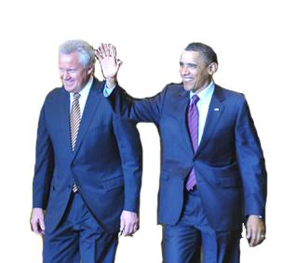
General environment
Legal and political conditions: President Obama signed the Affordable Care Act into law on March 23, 2010. Its objectives were strikingly similar to those stated by GE’s healthymagination program.
Notes:
Legal and political conditions, President Obama signed the Affordable Care Act into law on March 23, 2010. Its objectives were strikingly similar to those stated by GE’s healthymagination program just one year prior: to improve quality, increase access, and lower the costs of health care in the United States. GE was in a unique position to take advantage of the business opportunities created by the new legislation.

Slide 16
Industry environment and competition
The threat of Entry: small due to the vast size of the company.
The threat of Rivalry: low, but only temporarily.
The threat of Substitutes: The threat of substitutes in the healthcare industry, like products from Siemens and Phillips, is high.
Notes:
The threat of new entrants for GE is small due to the vast size of the company. The technology industry requires a large capital and expense; it would be difficult for new entrants to obtain the cash and development essential to this industry. People already have a solid relationship with the brand name GE, and it would be very expensive for a new company to try and compete with it. It would require a great deal of capital in advertising to get a new company’s brand name out to the public.
GE’s top management is currently making very unique strategic choices relative to competitors. Particularly with Healthymagination. So, the threat of rivalry is low, but only temporarily.
Substitutes in the healthcare industry, like products from Siemens and Phillips, fulfill the same customer needs, but do so in different ways and at a cheaper cost, therefore, it is a high threat to GE.

Slide 17
Industry environment and competition
The threat of Powerful Suppliers: The bargaining power of suppliers is relatively low for GE’s many industries.
The threat of powerful buyers: Buyer switching costs are high, so the threat of buyers is low.
Notes:
Slide four: Due to the sheer volume of goods that GE buys from their suppliers, the suppliers have no ability to bargain with GE. Most of GE's suppliers could not survive if they lost GE's business.
For many healthcare companies, such as GE, the volume per buyer is very large in both quantity of goods and the cost of goods. This makes the switching cost for buyers high, giving GE yet another advantage over their buyers. Now that I have told you about the external environment, David will tell you more about GE’s internal environment.

Slide 18
Resources
Financials reflect solid Stability
Operational and Financial diversity
Some of the best managers in the country
Intangible Resources
Notes:
The firm resources largely contribute to its past successes and future abilities. GE’s income statement and balance sheet reflect sold stability, whatever the macroeconomic situation. The market cap is boundless, allowing GE to fund nearly any project or capital expenditure. GE has gained operational and financial diversity through strategic capital expenditures; creating or acquiring businesses that grow sales and exploit vertical integration. The firm has a proven management training program, allowing GE to hire the best from within. Intangibles like innovation, imagination, and public perception are some of GE’s most invaluable resources. The increasing international sales and wide product depth balance the portfolio.

Slide 19
Strengths
Visionary Projects
Financial expertise
Strong management
International business know-how
Proven product lines
Notes:
Ecomagination and healthymagination are visionary projects. Mr. Immelt has committed large sections of the firm’s resources towards funding and expanding these missions. Ecomagination saw a capital expenditure of over 4 billion dollars; readying the firm for massive federal spending injections and sales during Obama’s green stimulus while other companies scrambled. GE is expounding upon that strategy by investing of nearly 6 billion dollars over 6 years into healthymagination. These “visionary” projects are possible because of leading R&D and financial expertise. Strong management has been at the company’s core since the beginning, whereas international business know-how has been developed over time. The firm’s proven product lines are solid cash cows, providing the ability of taking on new endeavors.

Slide 20
Weaknesses
Weak stock price
Plateau of sales
Falling profits
Unhappy investors
Unfocused “vision”
Notes:
GE’s stock price has faltered for an entire decade due to the plateau of sales and shrinking profit margin.
Revenue in 2010 is nearly equal in to revenue from 2005, actually falling from 150 billion ,242 million to 150 billion, 211 million. While revenue growth has stagnated in those years, net earnings has fallen over 4 and a half billion dollars. As you can see from the chart to the right, the Profit Margin has fallen over the last five years from 11 percent to just over 8 percent. Profits have went from bad to worse for GE, which historically has seen profit margins closer to 15%.
Investors are unhappy and their patience is running thin. Some would argue that GE has divested too much while others feel they should be leaner. Most agree that this visionary company needs focus. GE has taken on several intensive projects, gaining diversity but losing synergy in the process.

Slide 21
Competitive advantage
Product differentiation
Innovative new products
First mover in new technology
High quality products
Cost leadership
Innovative processes
Vertical integration
Notes:
GE enjoys varied competitive advantages because it is such as diverse company. The product differentiation comes from pioneering products that everyone is trying to imitate and the firm’s commitment to quality.
GE also has some cost leadership advantages through vertical integration and innovative processes.

Slide 22
Sustainability of competitive advantage
GE’s proven competitive advantage is sustainable.
GE’s particular strategy of Healthymagination may not be sustainable because of changing political environment. GE should be careful not to overcommit to Healthyimagination.
Notes:
These core competitive advantages are sustainable; established business units and proven processes can be maintained and improved to stay profitable. However, GE’s strategy of committing to large projects that coincide with legislation may not be sustainable because of the ever-changing political environment.
Now I touched briefly on some of the financials of GE, but Amanda is going to go into a little more depth with the company's performance and financial trends.

Slide 23
Financial Trends
10% decrease in stockholders
Decrease in stock price
Low: $6.66
Average: $31.37
High: $59.88
Substantial increase in cash
Notes:
Noticeable trends in GE’s financials include: 1) a decrease in common stockholders from 646k in 2005 to 578k in 2012, representing 10% fewer shareholders; 2) a faltering stock price over the last decade due to the plateau of sales and shrinking profit margins; and 3) a substantial cash increase from $9.011 billion in 2005 to $78,958 billion in 2010.
Valuing GE shares as either industrial or financial ignores the advantage its shareholders are getting from all sides. GE Capital, which acted as a suction cup on the share price for many years, is profitable again and directing cash to the corporate parent. That cash is acting as an industrial manufacturing war chest and leaving the parent free to use its current cash for increasing dividends and stock buy-backs.

Slide 24
Ratios
Profitability | Liquidity | Leverage
Net Profit Margin | Current Ratio | Debt-to-Equity
11.52% | 1.11 | 3.31

Slide 25
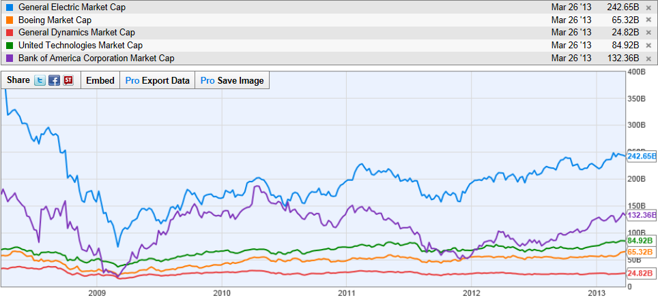
Market Capitalization
GE
Bank of America
United Technologies
Boeing
General Dynamics
Notes:
This is a graph of GE’s market capitalization over the last five years. This graph really emphasizes GE’s reliance on GE Capital and the impact that the 2008 financial crisis had on the firm’s finances. The blue line here, representing GE, falls directly in line with trends from Bank of America, the purple line. The manufacturing companies seen below have experienced only minimal fluctuations by comparison.

Slide 26
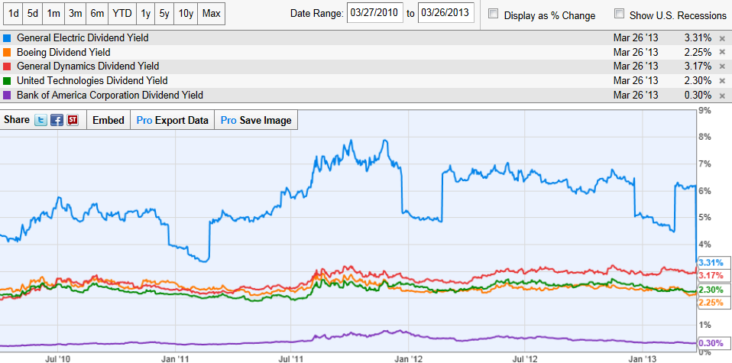
Dividend Yield
GE
General Dynamics
United Technologies
Boeing
Bank of America
Notes:
This graph represents GE’s dividend yield. As you can see here, GE, the blue line again, has a much higher dividend yield on average compared with both manufacturing firms and Bank of America. Even during decreases in dividend yield, GE is well above the competition.

Slide 27
Divest non-manufacturing industries
Return to its historical focus
Go from unrelated diversification to related
Reverse Course
Do Nothing
And Avoid the risks of:
Tying strategy to legislation
Gambling with share prices
Being too diverse
Stay the Course
Pursue Innovation and solve global problems through the –magination initiatives
Notes:
------Now that we have finished our analysis. GE has three viable options it can pursue as it looks toward the future: (((Click))) Option 1) GE can do as many investors are calling for and reverse course. GE would have to fire Immelt and divest non-manufacturing industries in order to position itself around its historical focus on industrial products and services. This is a viable option, GE’s focus has always been on diversified industrials, they have clear competencies and competitive advantages within this option. But you know what, GE is not ready to back down yet, and neither are we. GE is not a backward moving company. This one is out. (((Click)))). Option 2)
------The company can push the pause button on what its doing and see how the external environment develops. They can avoid the inherent risks of tying strategy with volatile legislation, gambling with already below-average share prices, and diversifying beyond the firm’s capabilities to manage that diversification. We like this option – because the future is so uncertain and this is evens out the risk. We believe GE is on the right track but we wonder… what if they’re getting ahead of themselves? What if the world isn’t ready? This option doesn’t move them backward or forward. But you know there’s a quote by Will Rogers that you might be on the right track, but if you just stand there what’s going to happen? you'll get run over. We won’t let GE get run over. Which leads us to our next option, (((Click)))
------3) Keep on Keeping On. We looked at this case and asked ourselves: Is this really what GE needs to be doing right now? Does it make good business sense? But we realized that too often in﻿ life we look at the price of doing something and we don't look at the cost of not. If Healthymagination can save one person’s life, isn’t that something worth doing? Ultimately this case isn’t asking us to decide on a new strategy for GE, the strategy they have chosen is fine. The challenge is how can we make their strategy of pursuing innovation and solving global problems through the -magination initiatives, how can we make that strategy work? GE doesn’t need imagination AT work, they need imagination TO work.

Slide 28
Divest Declining Businesses
Update Management Training Programs
Aggressively acquire and create new businesses
Coordinate with IT firms to create “smarter” technologies
Focus on International Growth
Seek Stakeholder Buy-In
Notes:
To make this work, GE needs to: (((Click))) 1) update management training programs by incorporating an emphasis on innovation, entrepreneurial leadership, and global problem solving. Managers need to understand one thing: what got us here, won’t get us there. It always takes new tools, new strategies, new techniques, and new ways; (((Click))) 2) divest declining businesses if they do not create synergy with Healthymagination. Ultimately anything that seeks to change the way we do healthcare around the world needs to be Titanic by nature. It will take a huge effort, but GE is a huge company and it can rise to this challenge, as long as it doesn’t stretch itself too thin; (((Click)))
3) seek to gain stakeholder buy-in throughout all aspects of the company; GE needs to open up minds, spark conversations, and explore healthcare on a personal level with investors and employees alike. (((Click))) 4) aggressively acquire new healthcare businesses to increase market share and deepen the innovation pipeline. Jack Welch, the former CEO of GE, said that “if the rate of change on the outside exceeds the rate of change on the inside, then the end is near….” And the healthcare industry is one of the fastest growing industries of the world. GE’s managers will need a focus on entrepreneurial leadership in order to stay agile and relevant throughout the healthcare industry’s evolution. (((Click)))
5) coordinate with information technology firms to create “smarter” technologies. Healthcare isn’t a technology problem - we have a surplus of high-tech medical equipment – healthcare is a systems problem. Its going to take a combination of technology, computer information systems, and standardization to change healthcare; and lastly (((Click))) 6) focus on international growth and diversifying geographic scope in emerging economies. GE operates in over 120 countries. And energy and healthcare are a concern of every country.

Slide 29

Notes:
If there’s one thing that we need to communicate today, its that even though there were a lot of dark clouds in this presentation, we think that a bright sun is right behind them. Moving forward is risky, but success is attainable and the potential for rewards is limitless in terms of immeasurable goodwill and real economic returns. GE was started by a man who changed the world, and this strategy upholds his legacy as GE tries to create a better world… for generations to come.

Slide 30

Amanda Sellers
David Fisher
Jodie Vance
Josh Keck
Mengying Cao
Michael Dannals
Notes:
Thank you for listening to our presentation. We will now open the floor for your questions.

